Slide 1

NYC TAXI TRIP
DATA PIPELINE
Link github: https://github.com/mufidnuha/nyc-taxi

Slide 2
OBJECTIVE
Build a data pipeline to retrieve and collect some taxi trip data such as yellow taxi trip, green taxi trip, and location zone data. Once collected, the data is transformed, cleaned, and combined according to business needs and then stored in the data warehouse so it can be easily used for analysis purposes.

Slide 3
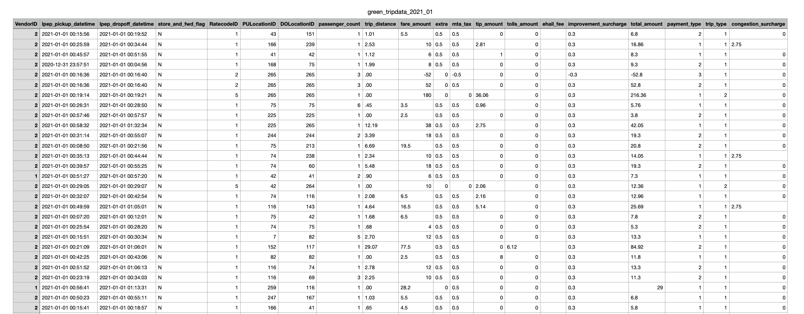
DATA SOURCE
This project used taxi trip records in 2020-2021 such as:
1. Yellow Taxi Trip Records (>1 million records per month)
2. Green Taxi Trip Records (> 1 million records per month)
3. Taxi Zone Lookup Table
NYC Taxi data can access on https://www1.nyc.gov/site/tlc/about/tlc-trip-record-data.page
Sample Data

Slide 4
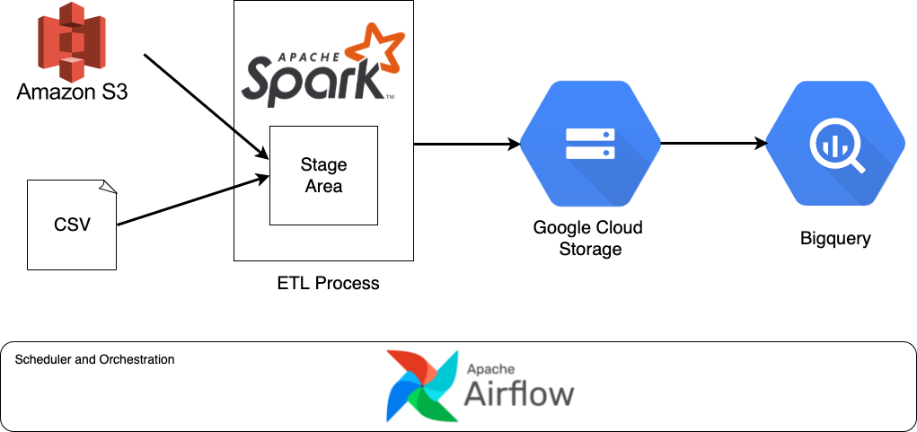
DATA PIPELINE DIAGRAM
Data from AWS S3 is extracted and stored in the staging area
1
Data is processed and transformed using Apache Spark
2
3
Data is loaded Google Cloud Storage as a data lake in parquet format
From GCS, data is retrieved and stored to Bigquery as data warehouse
4
All workflows in this pipeline are managed and scheduled by Apache Airflow
5

Slide 5
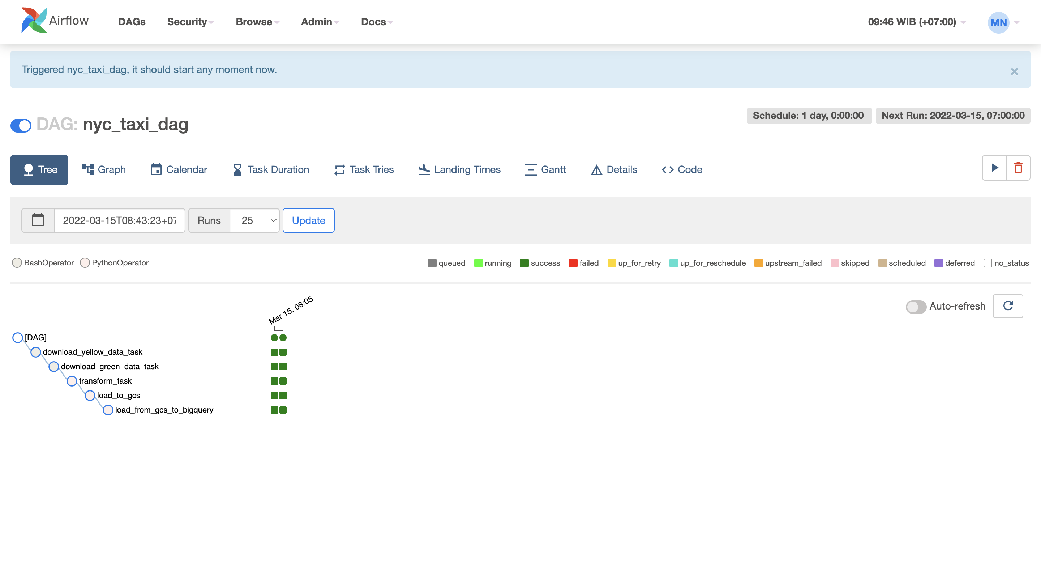
RESULTS:
AIRFLOW DAG IN TREE VIEW

Slide 6
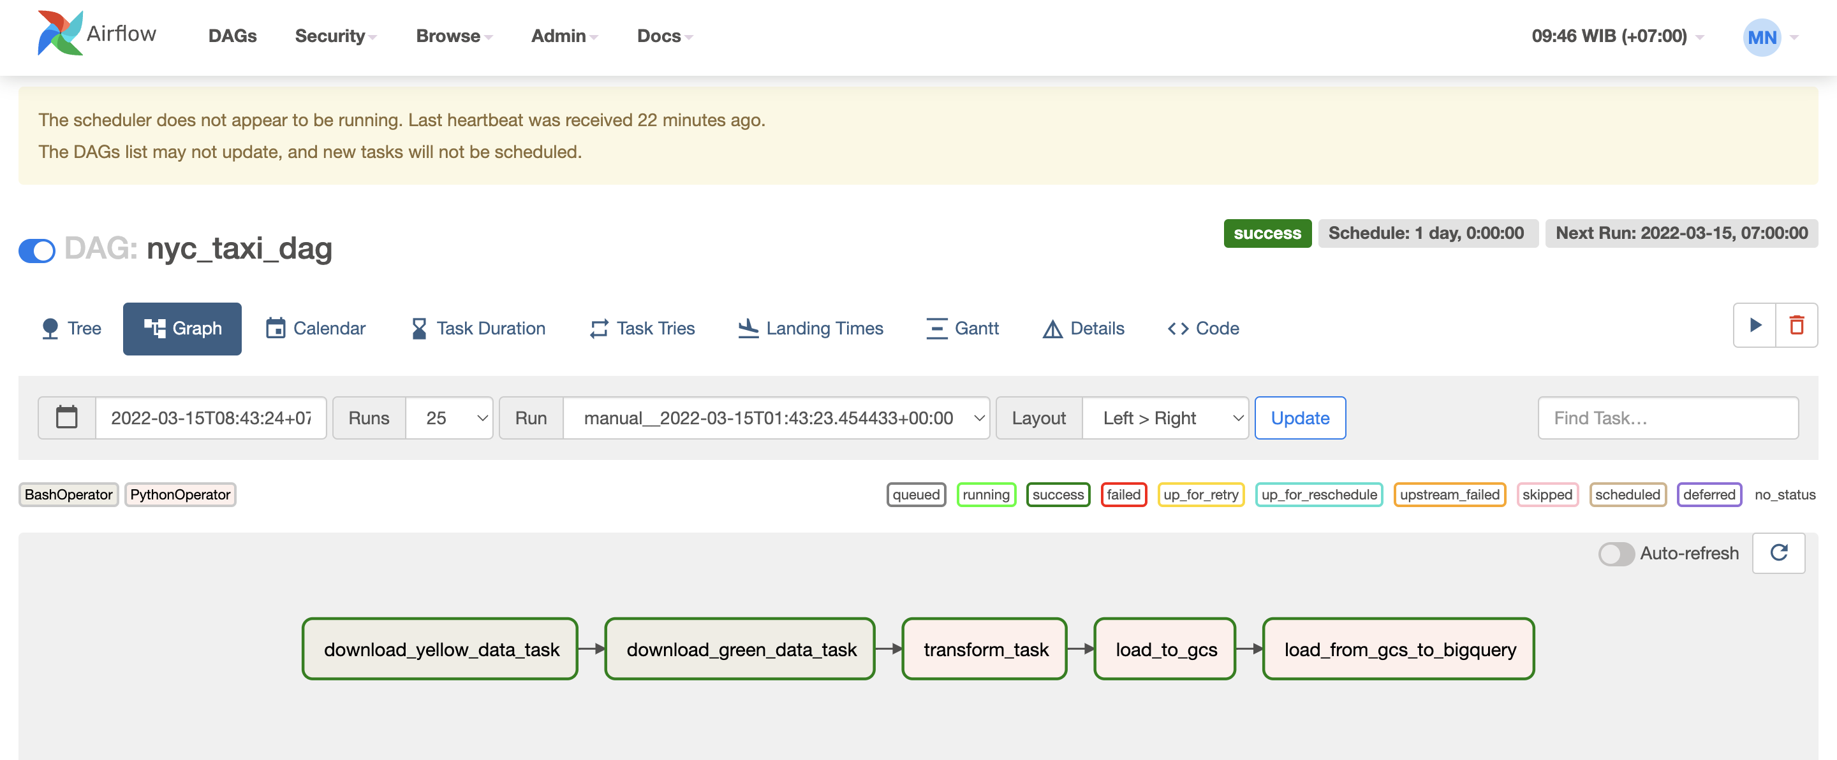
RESULTS:
AIRFLOW DAG IN GRAPH VIEW

Slide 7
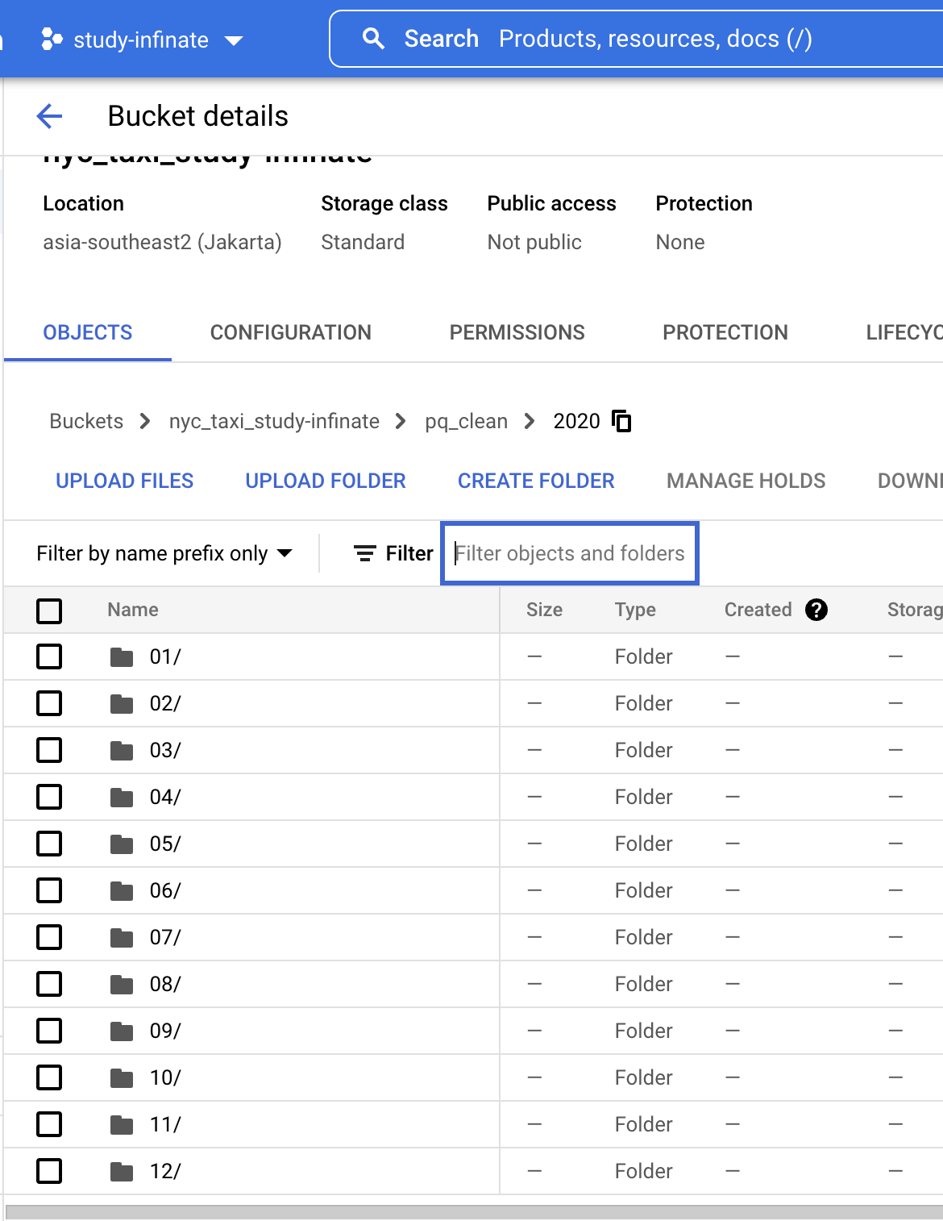
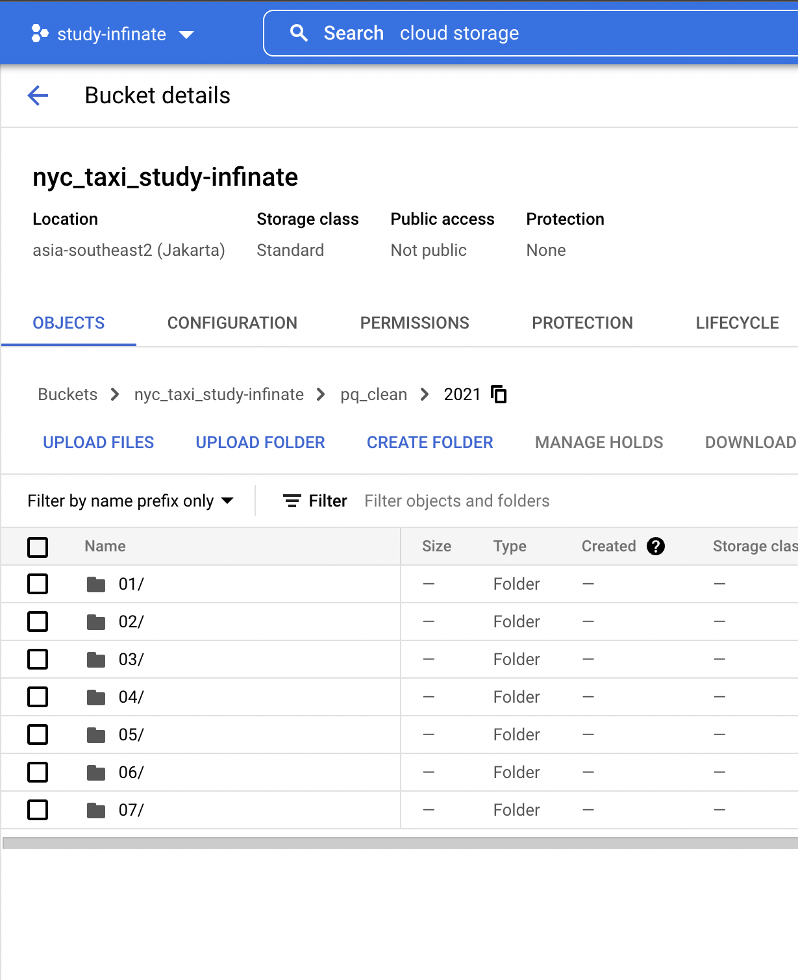
RESULTS: GOOGLE CLOUD STORAGE
The results of the data transformation are stored in Google Cloud Storage.
Data is stored by month and year.
Data is stored in parquet format to support fast data processing for complex data.
2020
2021

Slide 8
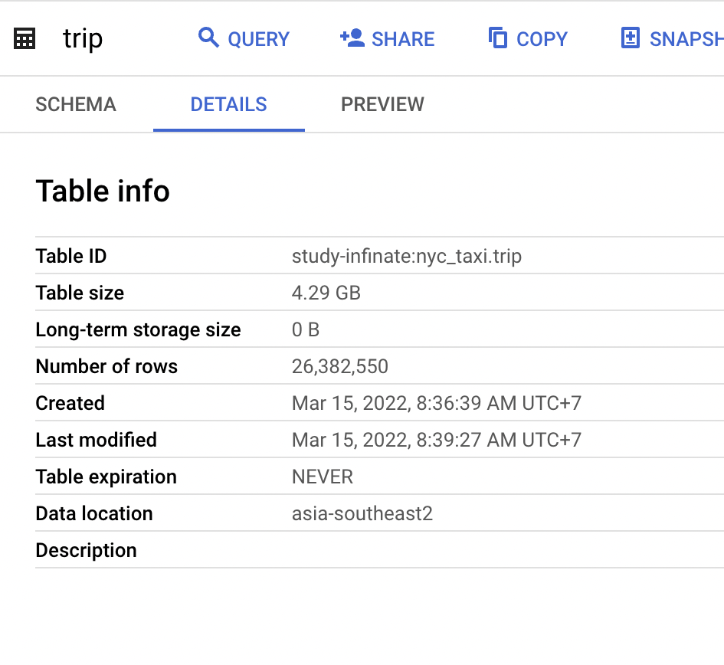
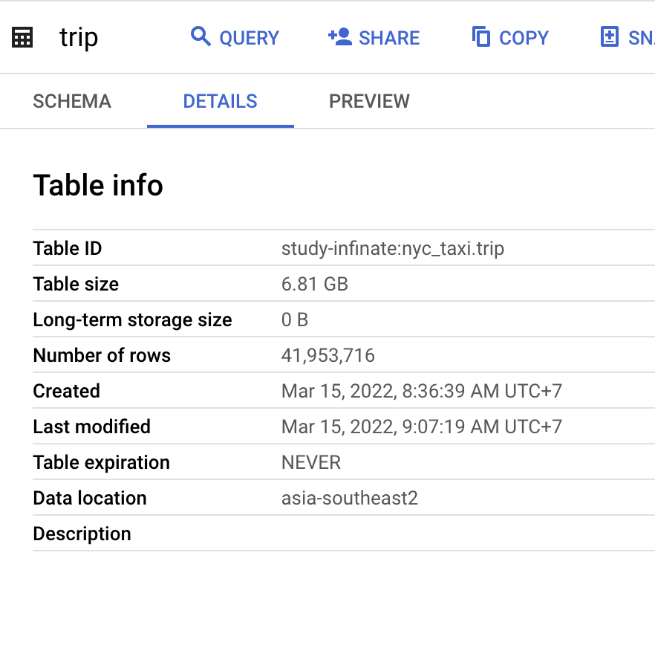
RESULTS: BIGQUERY
Details of the table after added taxi trip data in 2020
Number of records: > 26 million
Details of the table after added taxi trip data in 2021
Number of records: > 41 million

Slide 9
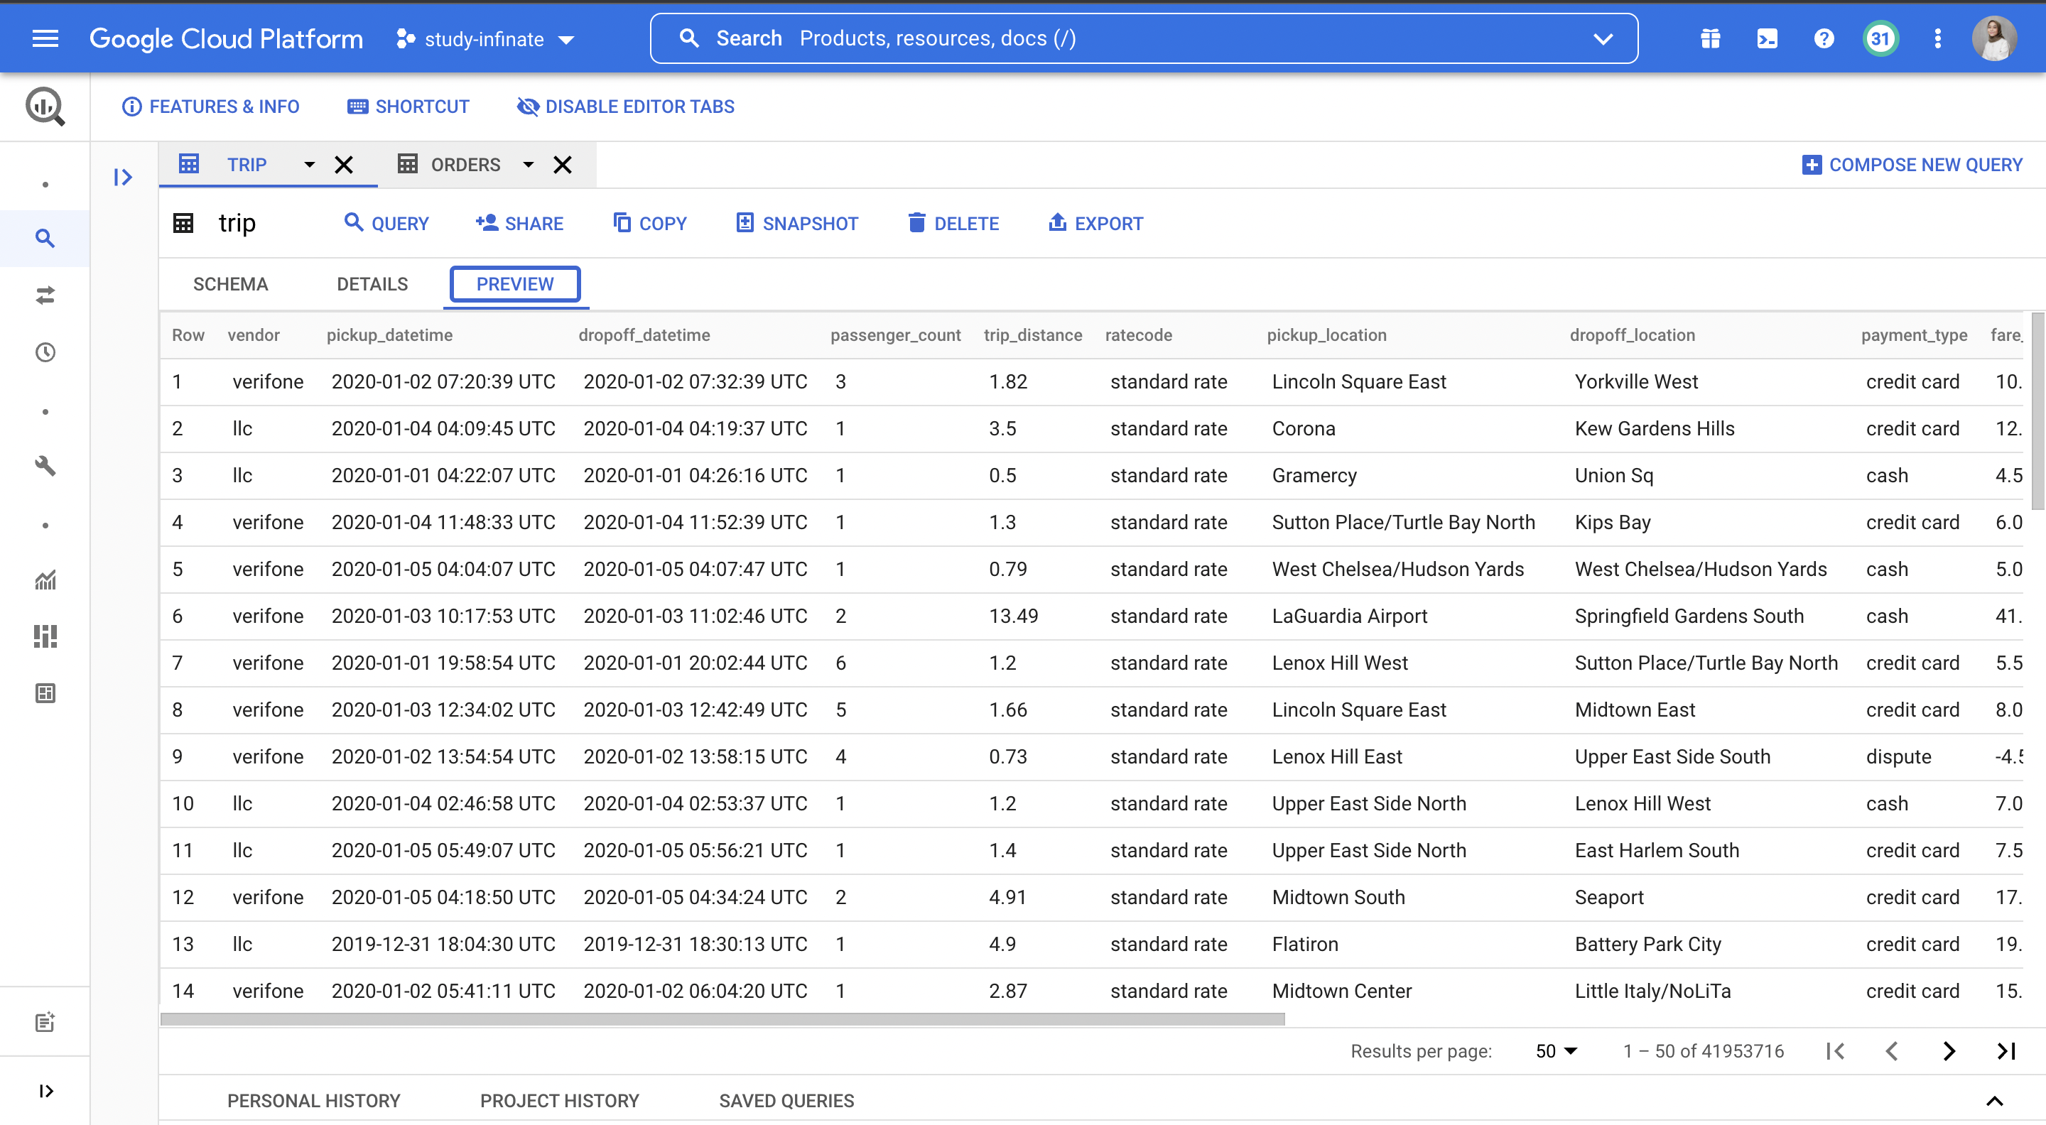
RESULTS: PREVIEW TABLE ON BIGQUERY

Slide 10
Thank You

